Slide 1
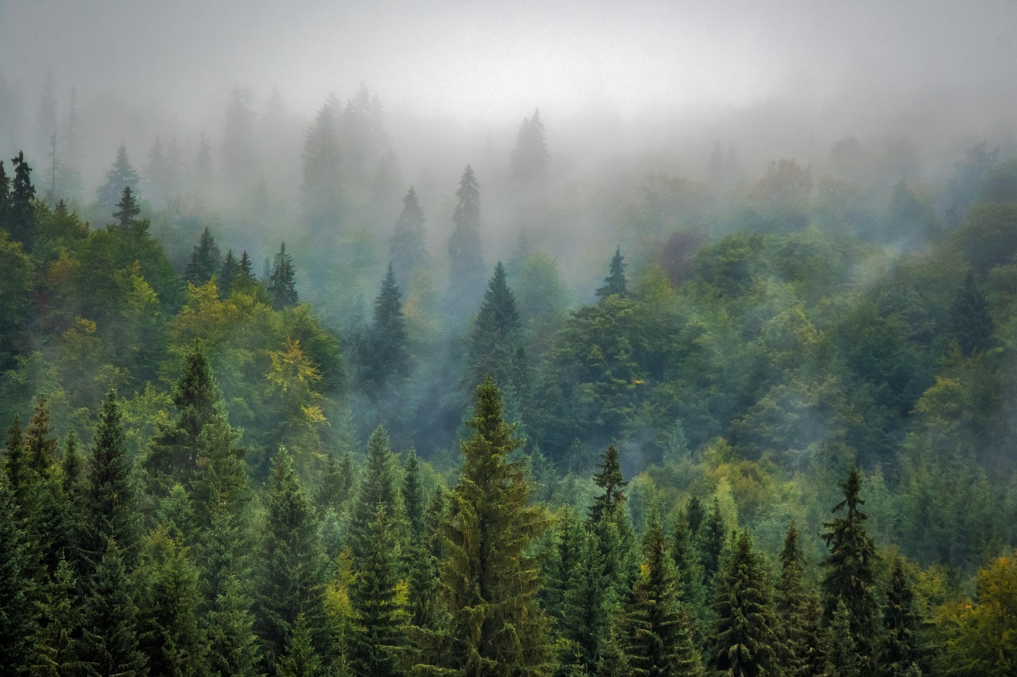
Hackathon Presentation
A TREE LEVEL
CHANGE DETECTION
Across Maharashtra Using Deep Learning
Members PRN
Miss. Amruta Pandurang Mali. 2203089
Miss. Pooja Raju Kamble. 2203093
Mr. Vinayak Prashant Patil. 2203138
Mr. Pritivardhan Mahesh Chothe. 2203106

Slide 2
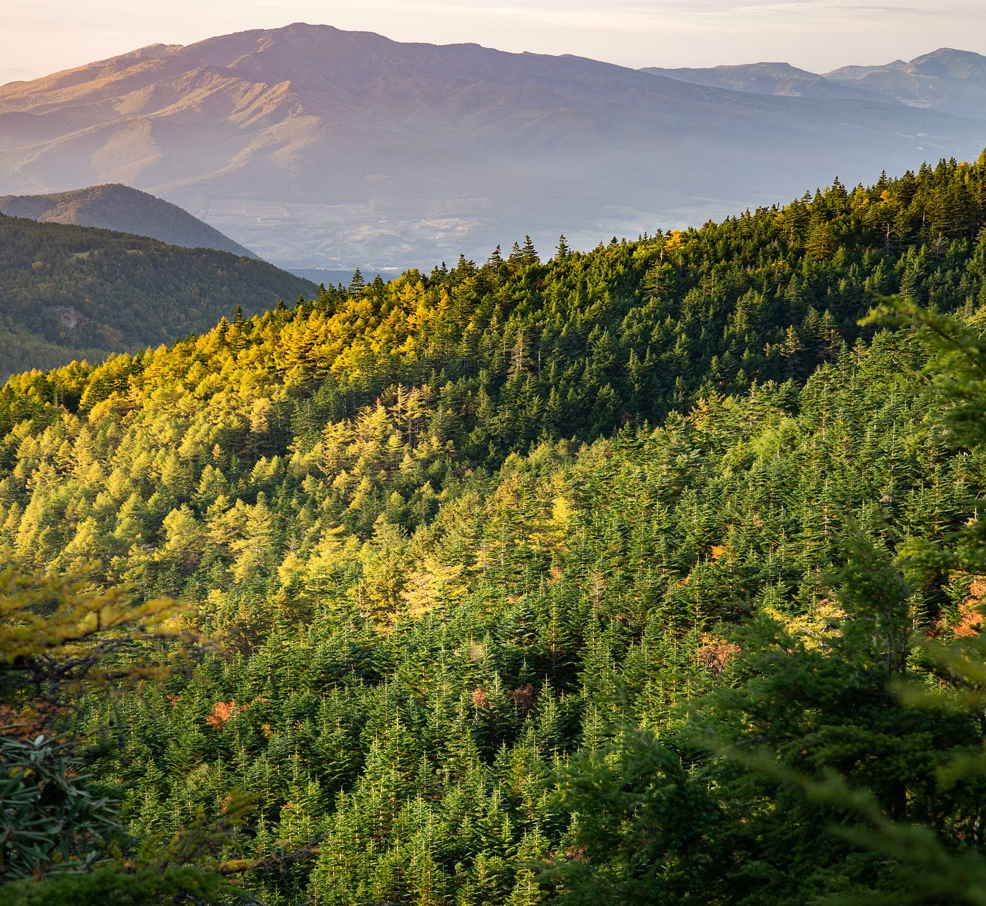
INTRODUCTION
Maharashtra, India's Green State, has a vast forest cover of 61,576 square kilometers, making up 20% of the state's total geographical area. However, the rapid clearing of forests, despite the existence of forests conservation acts and laws since 1964, is causing significant deforestation. Infrastructure projects like national highways, electricity bridges, and train tracks are causing tree loss, while pollution, construction, and real estate development are reducing tree numbers in urban areas. The government claims to be running replantation programs, but the scale of deforestation is often not accurately monitored. To address this issue, image processing with Machine Learning and Deep Learning techniques can be used to detect greenery and void space for plantation through satellite images, identifying regions that need reforestation.

Slide 3
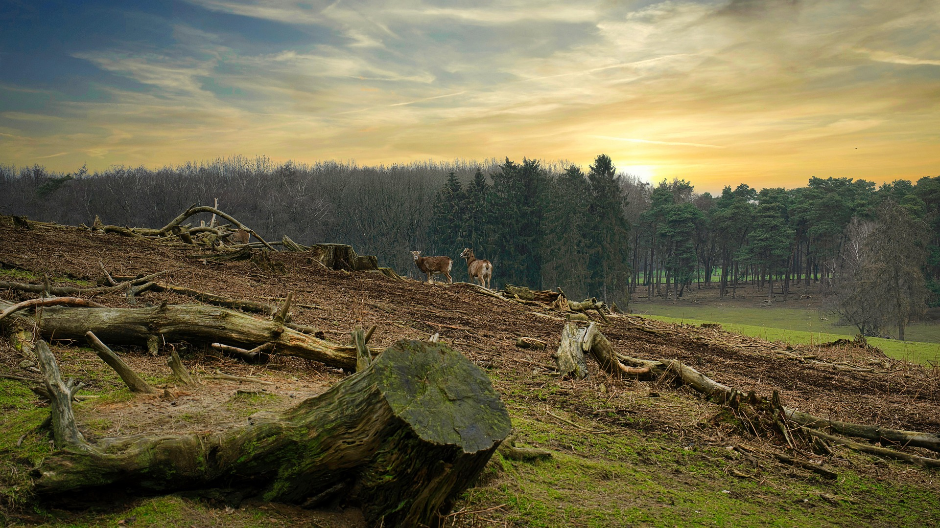
Deforestation is occurring at an alarming rate.
PROBLEM STATEMENT
Government replantation efforts lack proper tracking.
Existing manual surveys are inefficient.
Need for an automated system to detect and categorize deforestation zones.

Slide 4
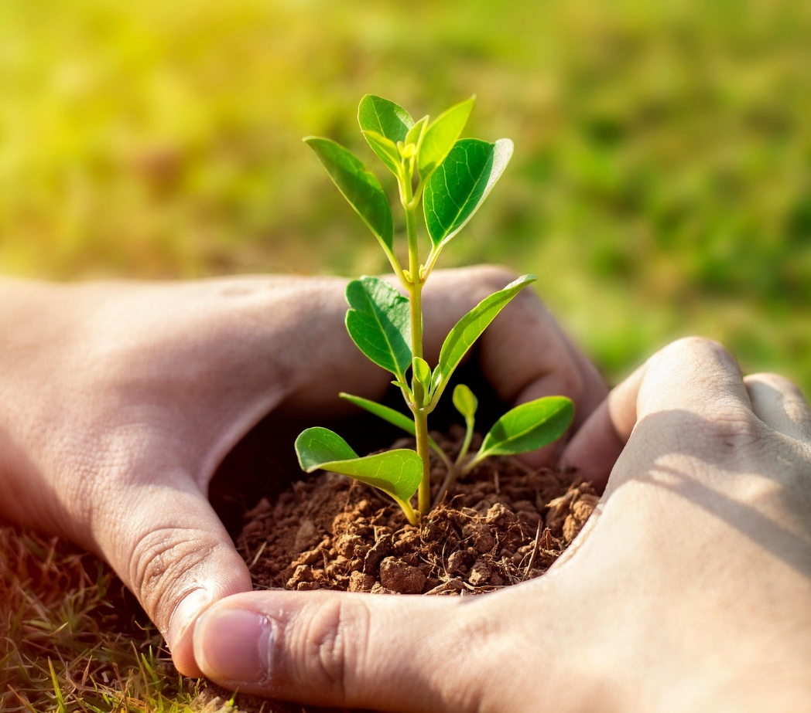

Satellite
Imagery
Collection
Collect multi-temporal satellite imagery of Maharashtra.
Images Processing
Preprocess images to remove noise and normalize data.
Model
training
Train a model for tree cover change detection.
PROBLEM
OBJECTIVE
Zone
Classification
Identify and classify regions into red, orange, and green zones.
Geospatial
Analysis
& Insights
Provide geospatial insights to policymakers and environmentalists.

Slide 5
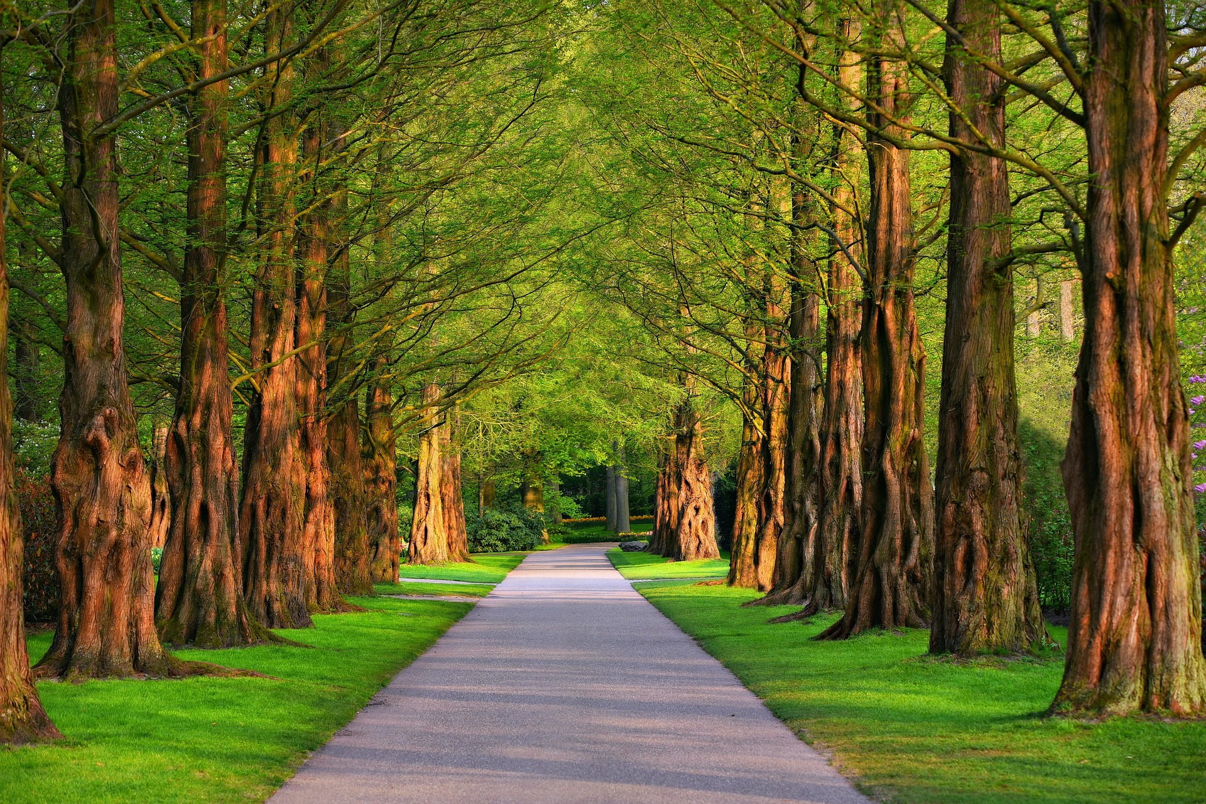
PROPOSED
SOLUTION
Collect high-resolution satellite images from Sentinel-2 and Landsat.
Preprocess images using image processing techniques.
Train a learning model (Random Forest/KNN/SVM) to detect tree loss.
Generate Table highlighting red (critical), orange (moderate), and green (stable) zones.
start

Slide 6
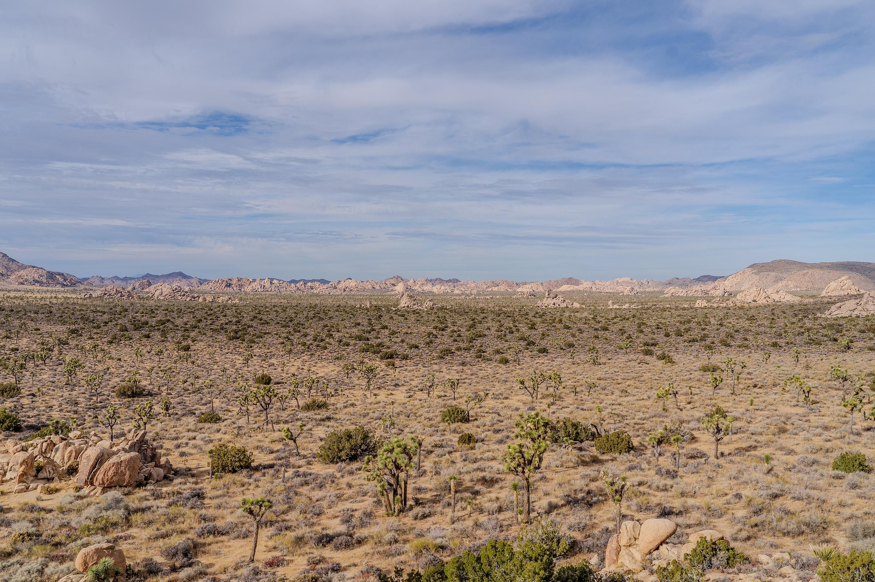
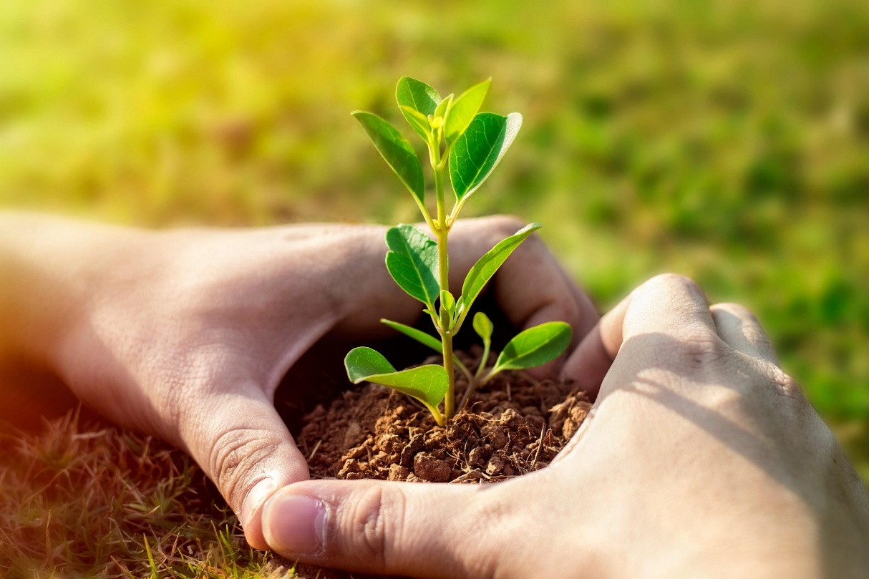
PROJECT
WORKFLOW
Data Collection
Preprocessing
Model Training
Analysis
Output Visualization

Slide 7


Methodology
Satellite imagery from Google Earth Engine.
Image processing using library CV2 and Skimage.Feature.
Data Processing
ML learning models (Random Forest/KNN/ SVM) for classification.
Zone Classification Based on Red/Orange/Green

Slide 8


System
Requirements
Intel i7/Ryzen 7 Processor, 16GB RAM, NVIDIA RTX 3060 GPU.
TensorFlow, PyTorch, Python, OpenCV, GD
Google Earth Engine for data collections.

Slide 9

Satellite
Imagery
Collection
Collect multi-temporal satellite imagery of Maharashtra.
Images Processing
Preprocess images to remove noise and normalize data.
Deep learning
Model
training
Train a deep learning model for tree cover change detection.
Expected
Outcomes
Zone
Classification
Identify and classify regions into red, orange, and green zones.
Geospatial
Analysis
& Insights
Provide geospatial insights to policymakers and environmentalists.

Slide 10
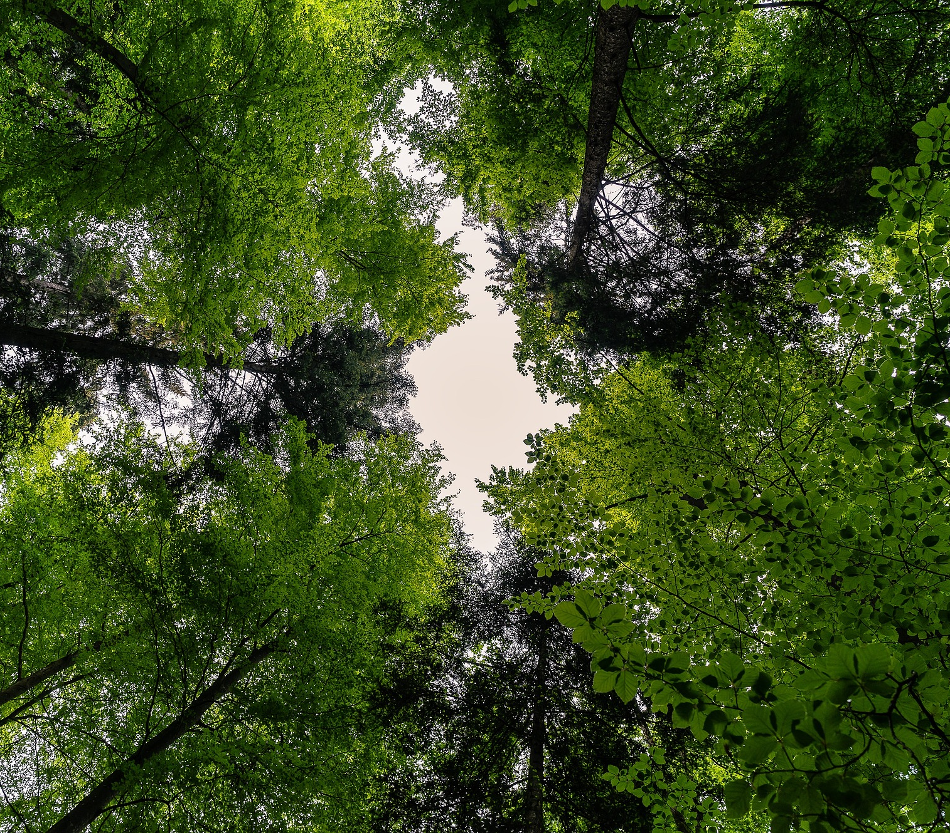
Point 1
Point 2
Point 3
Point 4
Point 5
This project provides an AI-driven approach to detect and analyze deforestation trends.
Insights to
assist policymakers and environmentalist.
Awareness about the need for tree plantations.
Implement real-time tracking and mobile accessibility.
Extend the system to other states or regions globally.
Conclusion
& Future scope

Slide 11
CAPSTONE PHASE-I
RESULTS

Slide 12
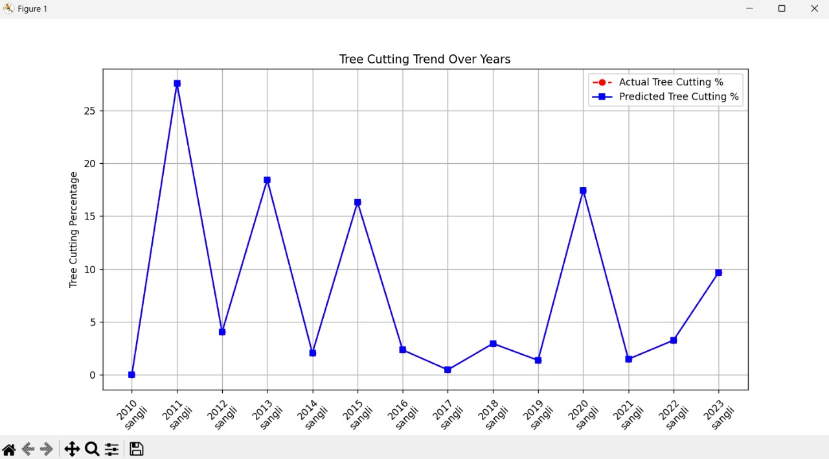

Slide 13
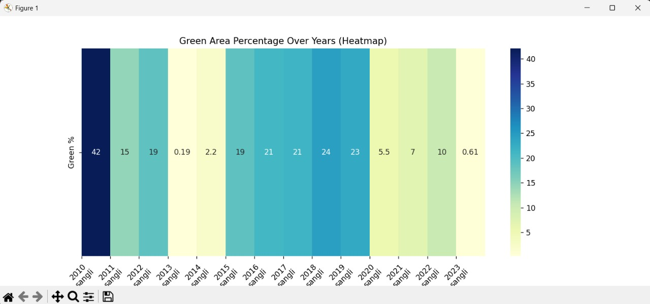

Slide 14
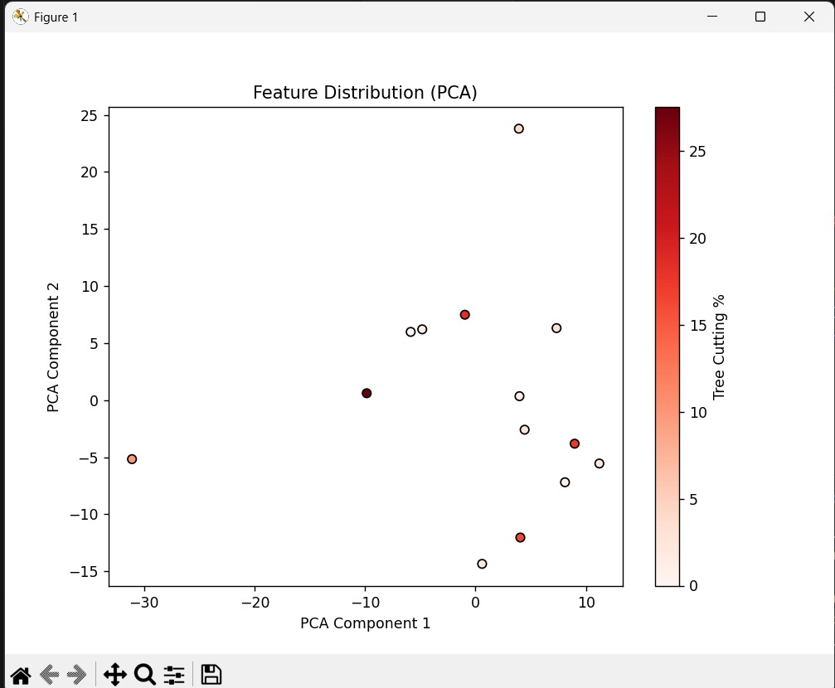

Slide 15
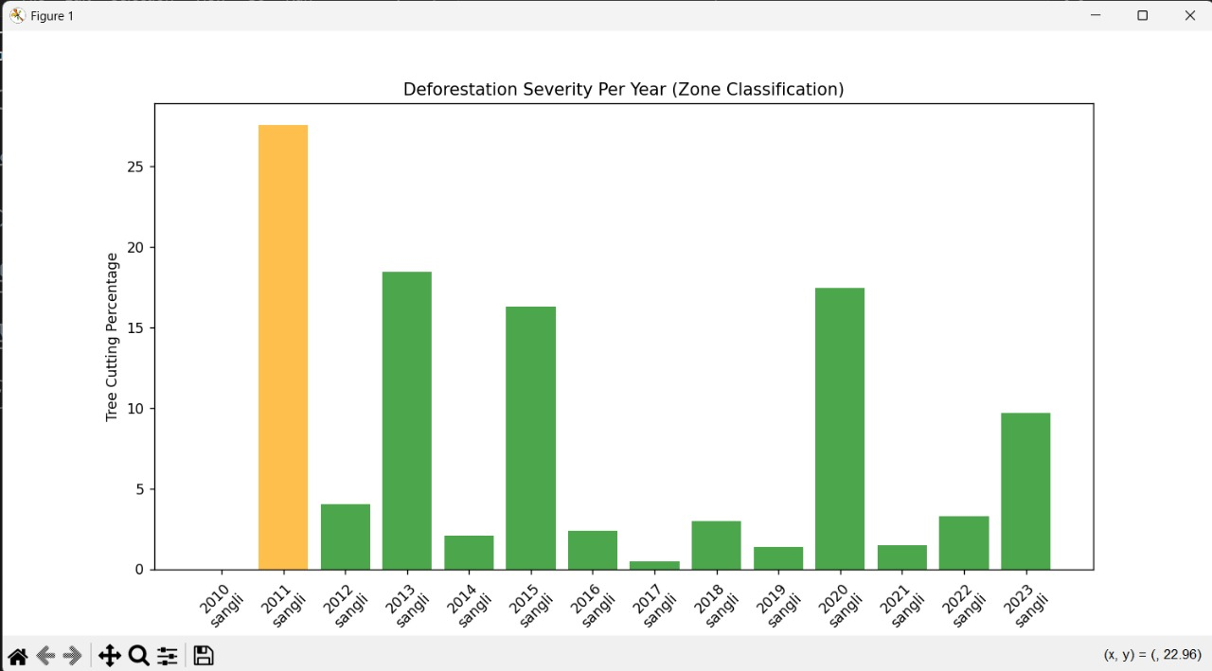

Slide 16
CAPSTONE PHASE-II
RESULTS

Slide 17
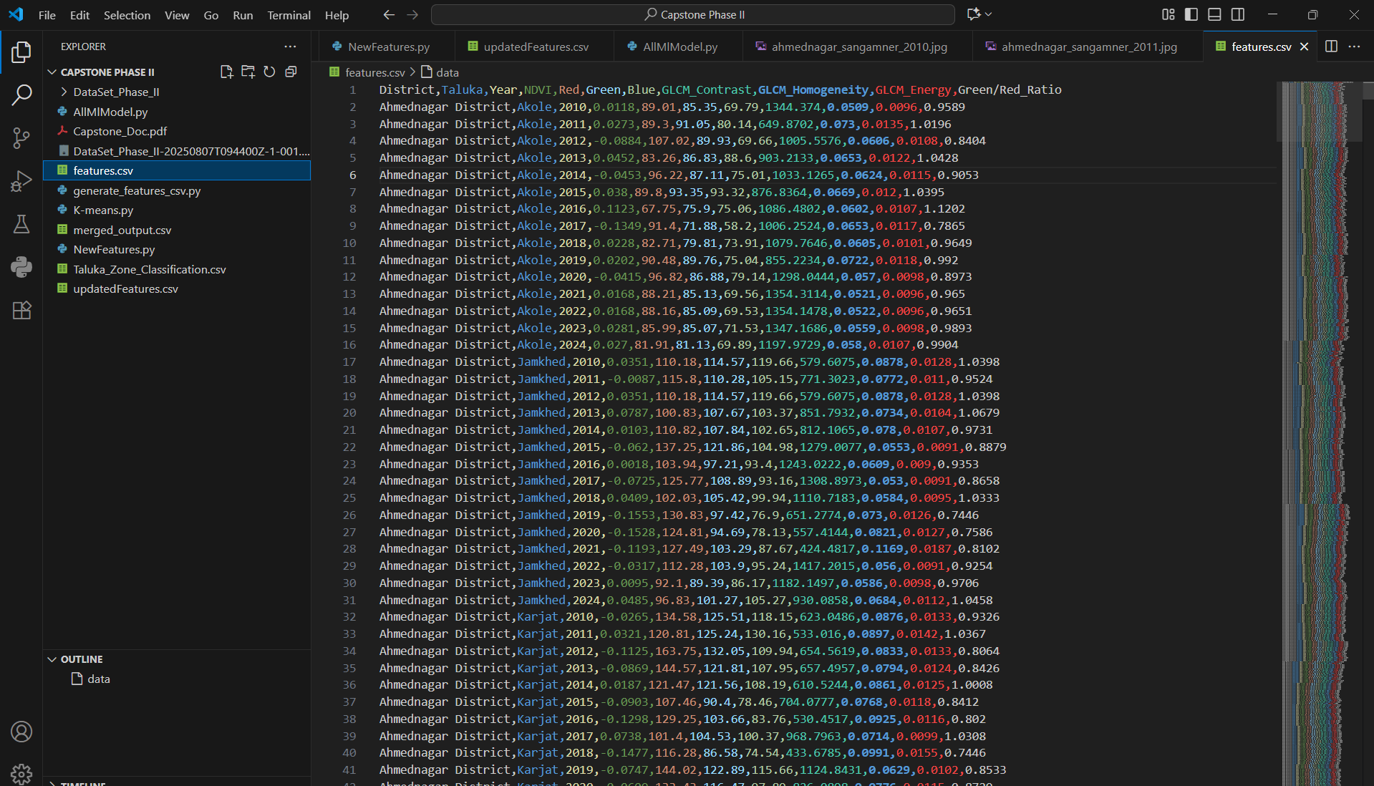

Slide 18
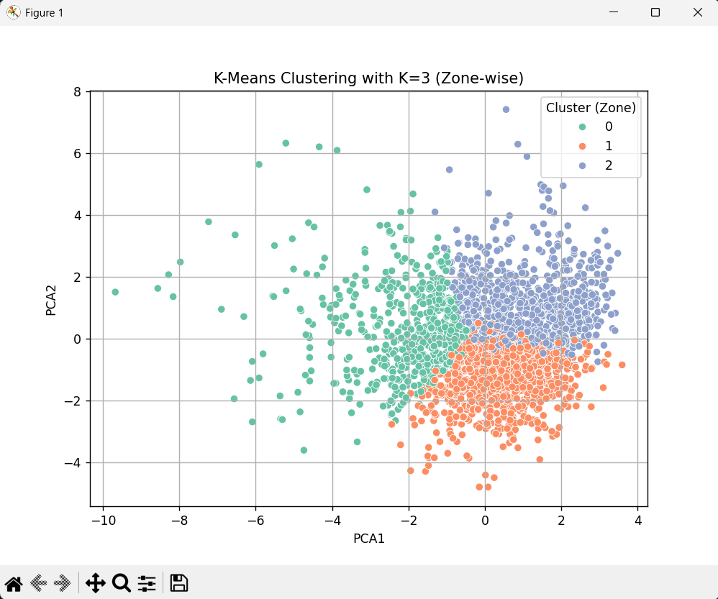

Slide 19
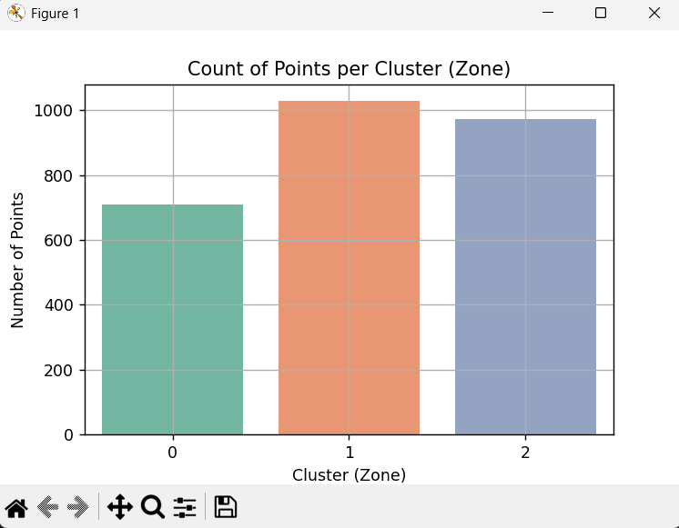

Slide 20
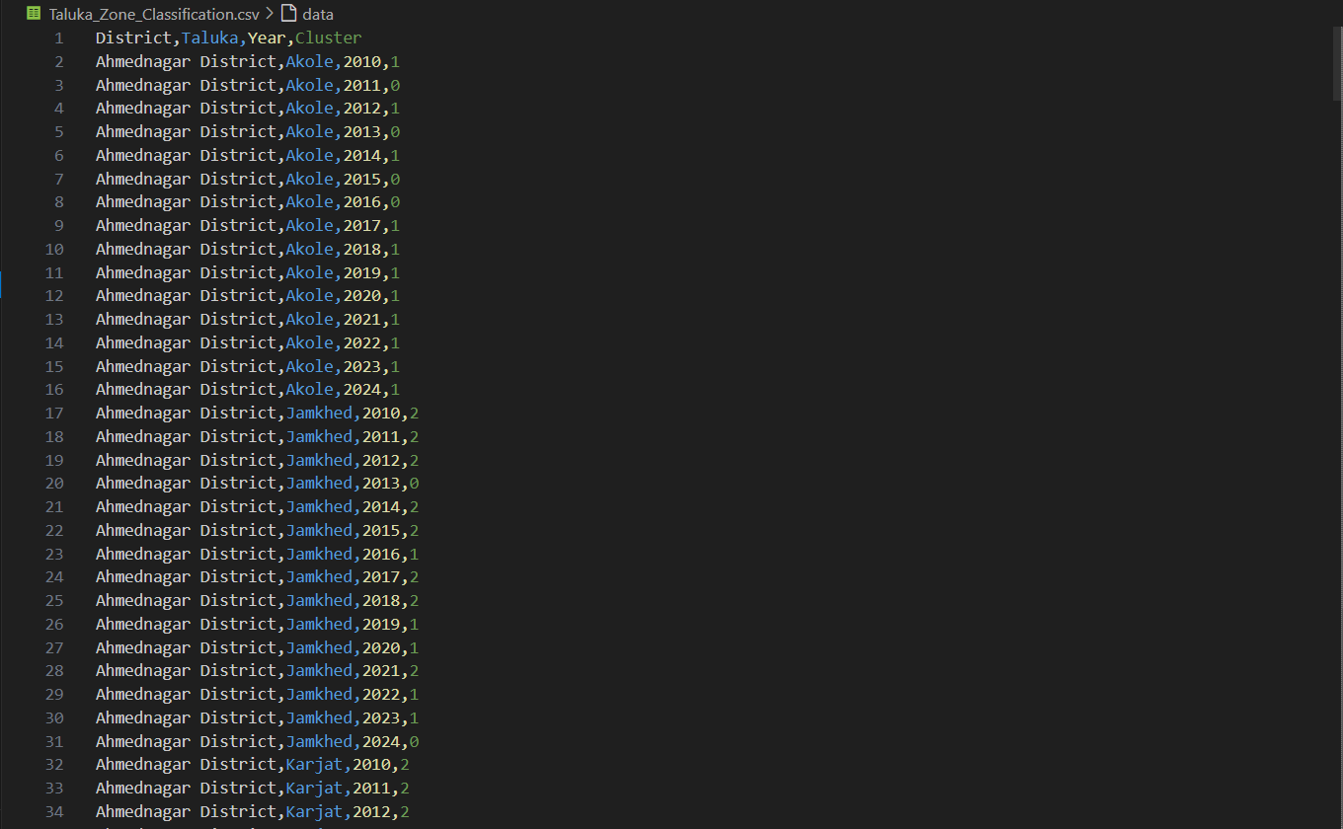

Slide 21
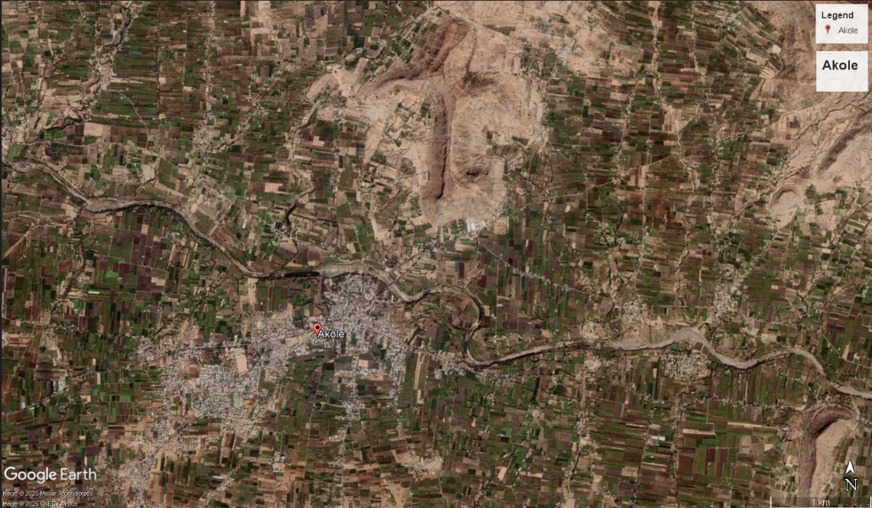
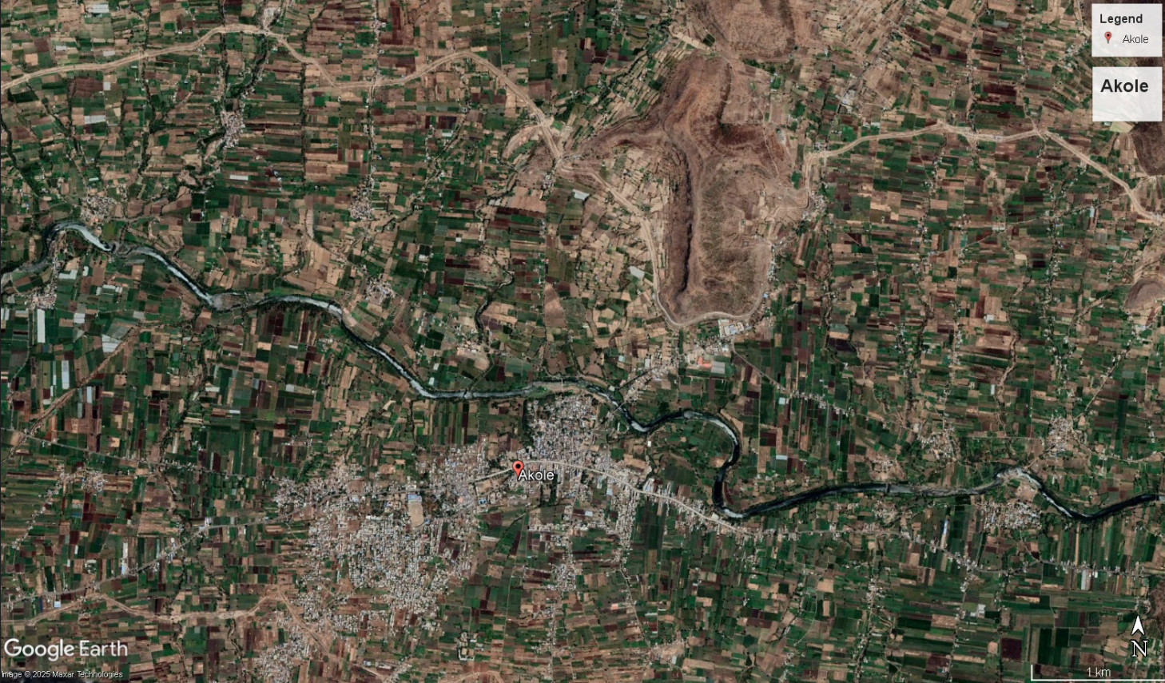
YEAR : 2012
YEAR : 2022

Slide 22
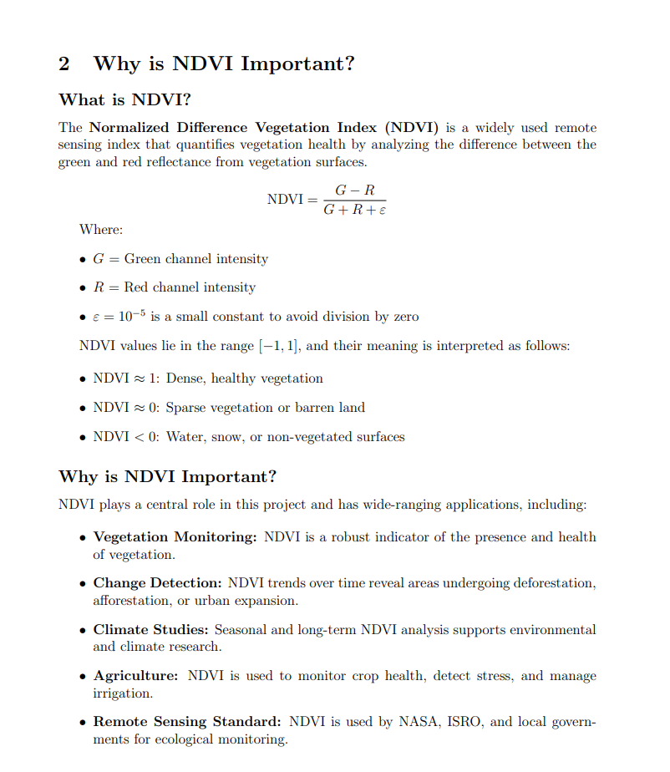

Slide 23

QUESTION
&
ANSWER

Slide 24
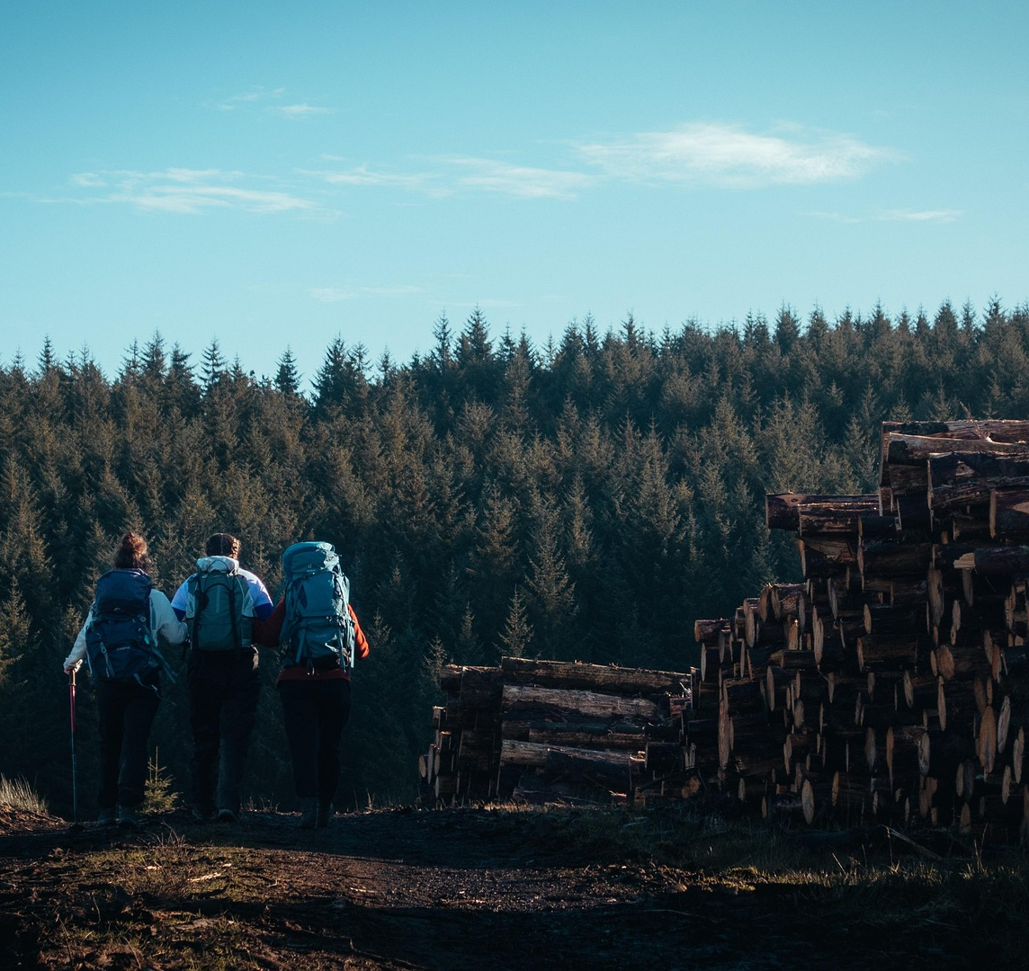

THANKS
thank you so much for
your attention

